Slide 1
应用系统体系架构 人工智能模块
A.5 课 What Is ChatGPT Doing … and
Why Does It Work?
from: https://writings.stephenwolfram.com/2023/02/what-is-chatgpt-doing-and-why-does-it-work/

Slide 2
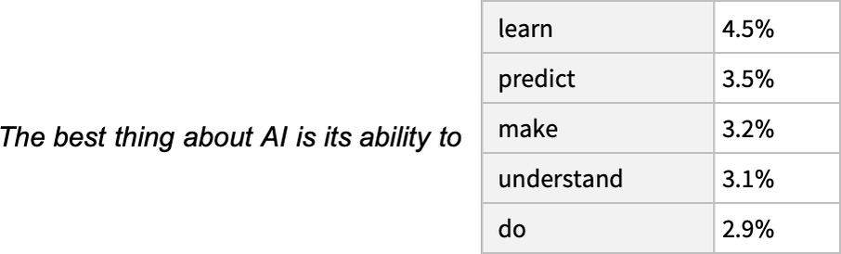
It’s Just Adding One Word at a Time
“The best thing about AI is its ability to”.

Slide 3
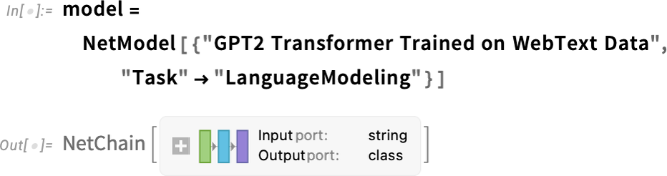
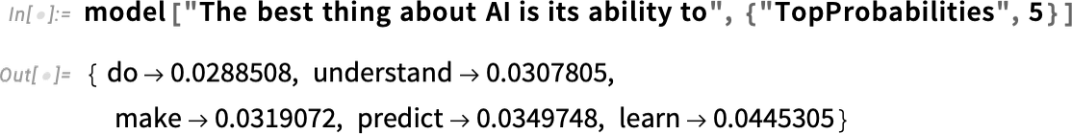
It’s Just Adding One Word at a Time
There’s a particular so-called “temperature” parameter

Slide 4
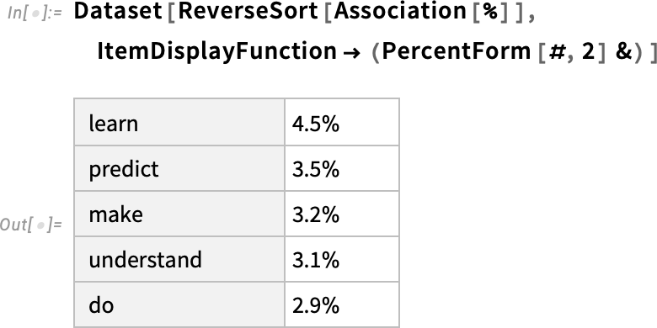
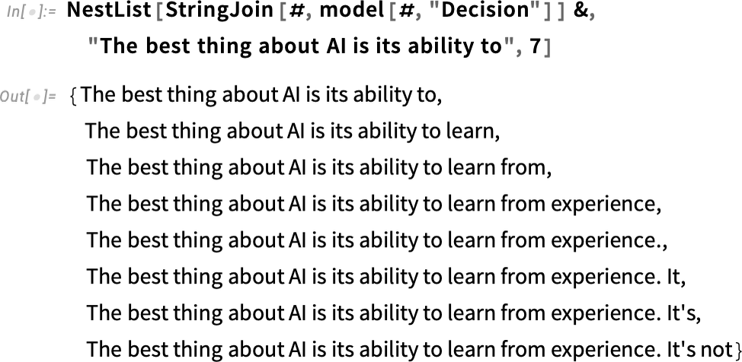
It’s Just Adding One Word at a Time

Slide 5
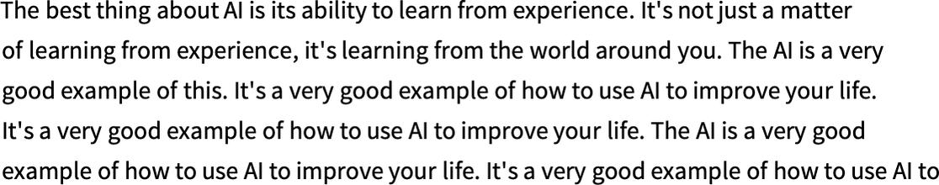
It’s Just Adding One Word at a Time
What happens if one goes on longer? (“zero temperature”)

Slide 6
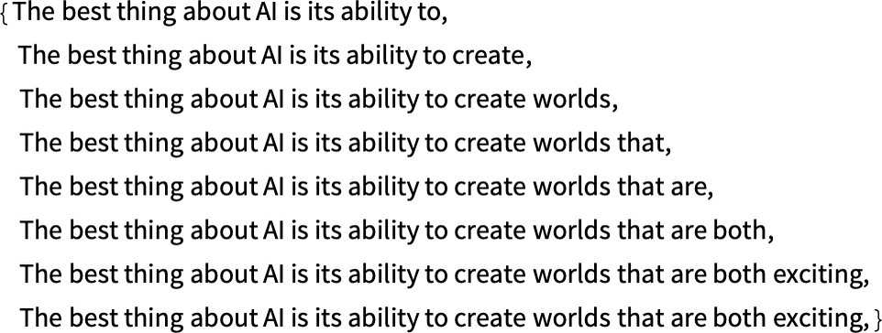
It’s Just Adding One Word at a Time
What if instead of always picking the “top” word one sometimes randomly picks “non-top” words
(with the “randomness” corresponding to “temperature” 0.8)?

Slide 7
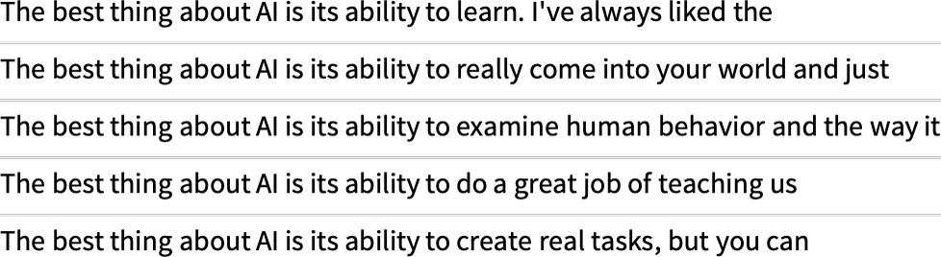
It’s Just Adding One Word at a Time
And every time one does this, different random choices will be made, and the text will be different

Slide 8
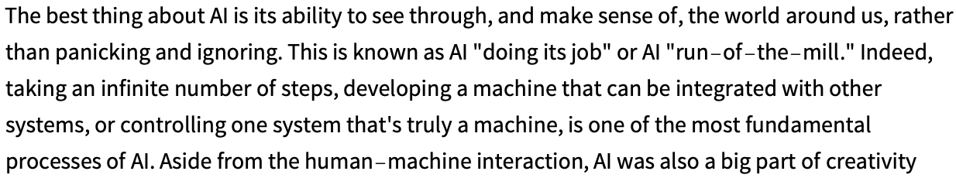
It’s Just Adding One Word at a Time
So what happens if one goes on longer?
This was done with the simplest GPT-2 model (from 2019).

Slide 9
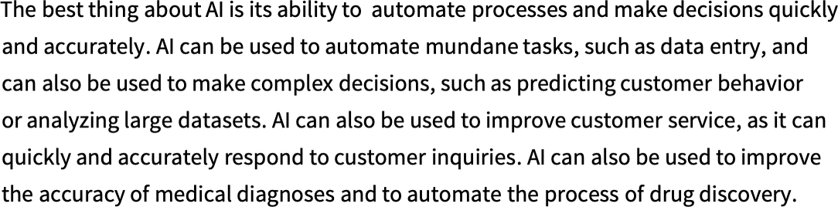
It’s Just Adding One Word at a Time
With the newer and bigger GPT-3 models the results are better.
zero temperature

Slide 10
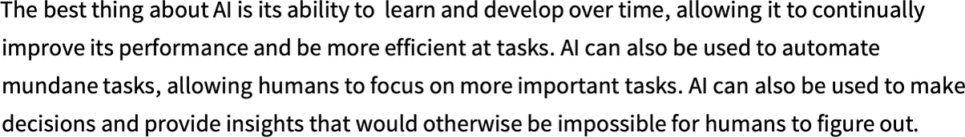
It’s Just Adding One Word at a Time
With the newer and bigger GPT-3 models the results are better.
Temperature 0.8

Slide 11
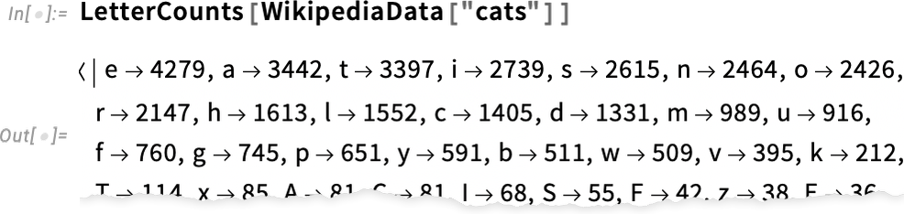
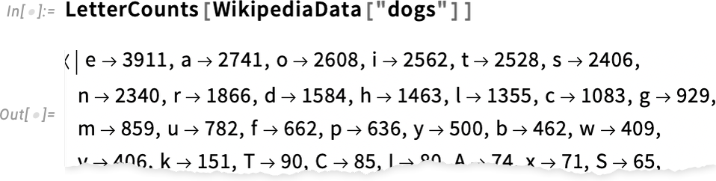
Where Do the Probabilities Come From?
OK, so ChatGPT always picks its next word based on probabilities.

Slide 12
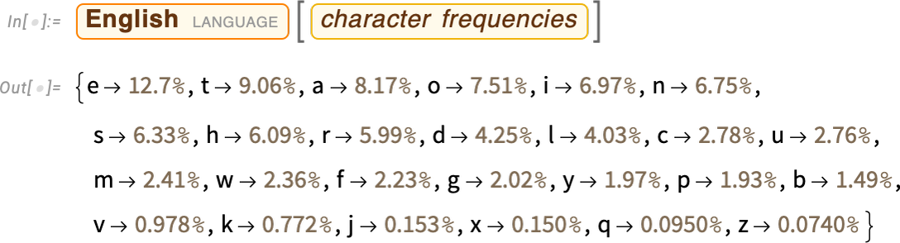
Where Do the Probabilities Come From?
OK, so ChatGPT always picks its next word based on probabilities.

Slide 13
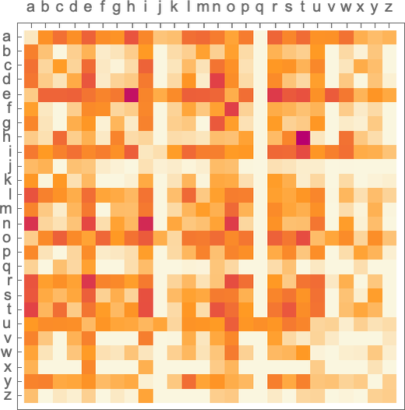
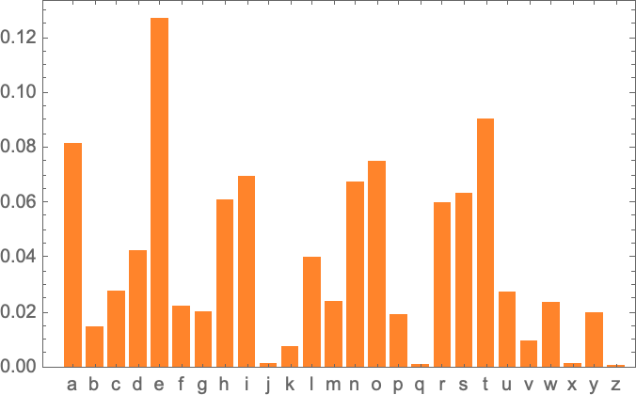
Where Do the Probabilities Come From?
“2-gram” probabilities

Slide 14
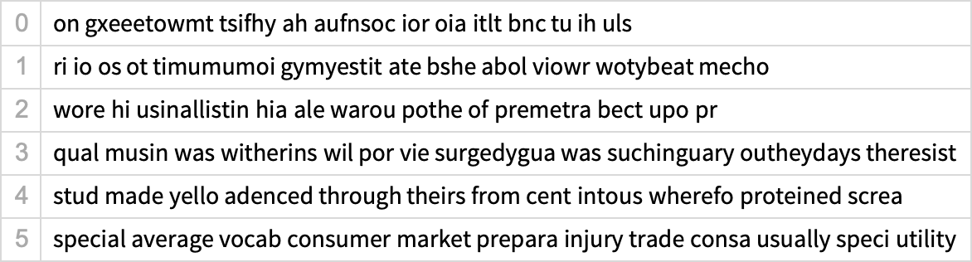
Where Do the Probabilities Come From?
n-gram probabilities

Slide 15
Where Do the Probabilities Come From?
But let’s now assume—more or less as ChatGPT does—that we’re dealing with whole words, not letters.

Slide 16
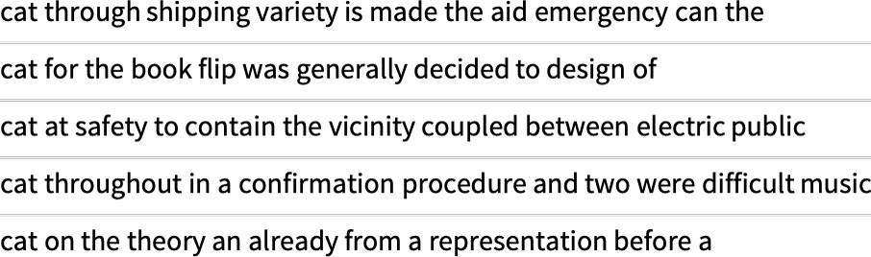
Where Do the Probabilities Come From?
Just like with letters, we can start taking into account not just probabilities for single words but probabilities for pairs or longer n-grams of words.

Slide 17
Where Do the Probabilities Come From?
But with 40,000 common words,
even the number of possible 2-grams is already 1.6 billion—and the number of possible 3-grams is 60 trillion.
So what can we do?
The big idea is to make a model that lets us estimate the probabilities with which sequences should occur—even though we’ve never explicitly seen those sequences in the corpus of text we’ve looked at.
And at the core of ChatGPT is precisely a so-called “large language model” (LLM) that’s been built to do a good job of estimating those probabilities.

Slide 18
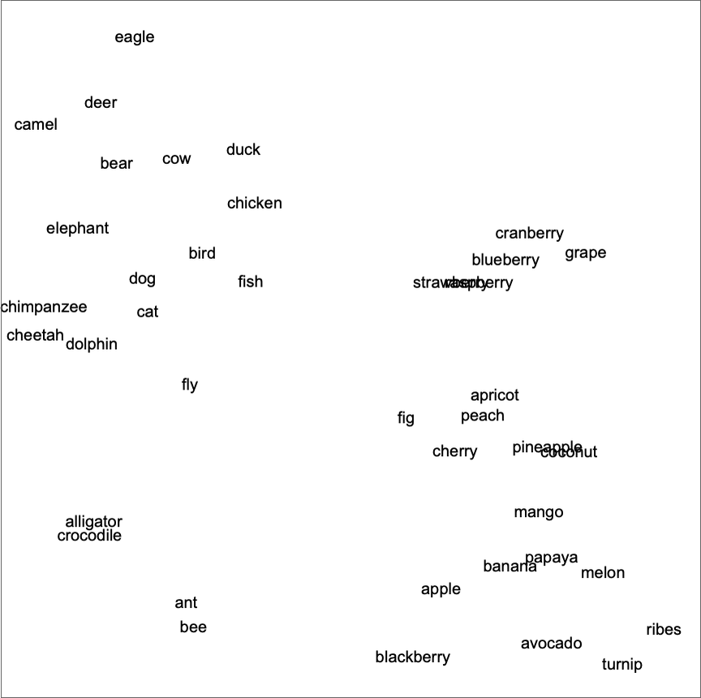
The Concept of Embeddings
The actual embeddings that are used—say in ChatGPT—tend to involve large lists of numbers.
2D

Slide 19

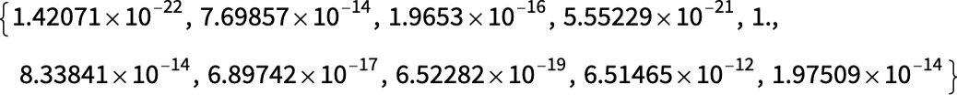
The Concept of Embeddings
Feed in the image and the values of the neurons in that last layer are:

Slide 20
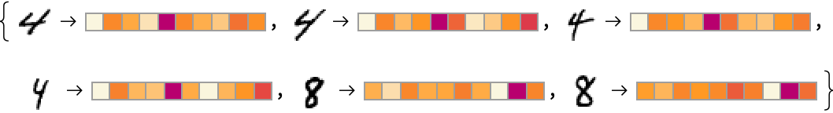
The Concept of Embeddings
Here we’re essentially using 10 numbers to characterize our images.

Slide 21
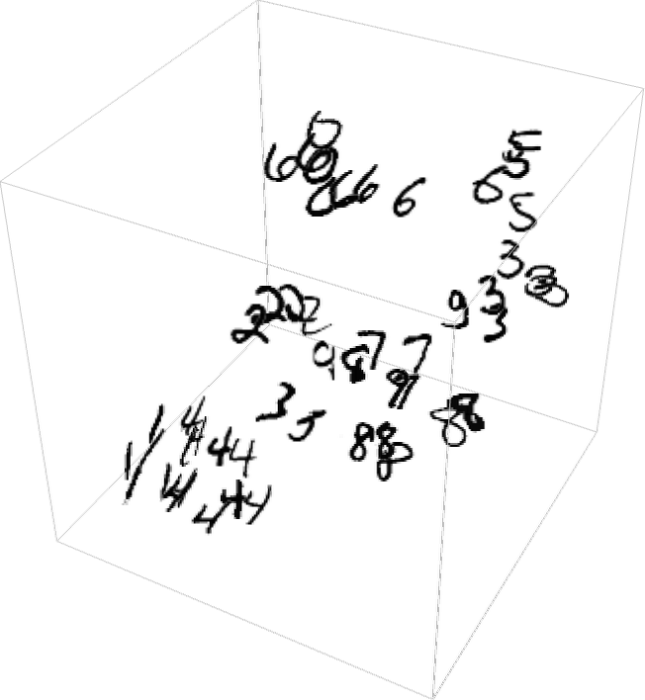
The Concept of Embeddings
But it’s often better to use much more than that.
We need to “reduce the dimension”, effectively by projecting the 500-dimensional vector we’ve got into, say, 3D space:

Slide 22
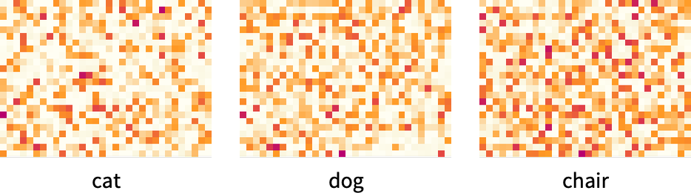
The Concept of Embeddings
Imagine we’re given “the ___ cat”.
Or, alternatively, given “___ black ___” what are the probabilities for different “flanking words”?
For example, here’s what GPT-2 produces as the raw embedding vectors for three specific words:

Slide 23
The Concept of Embeddings
And inside ChatGPT that’s how it’s dealing with things.
It takes the text it’s got so far, and generates an embedding vector to represent it.
Then its goal is to find the probabilities for different words that might occur next.
And it represents its answer for this as a list of numbers that essentially give the probabilities for each of the 50,000 or so possible words.

Slide 24
Inside ChatGPT
GPT-3 network with 175 billion weights
And its most notable feature is a piece of neural net architecture called a “transformer”.
It operates in three basic stages.
First, it takes the sequence of tokens that corresponds to the text so far, and finds an embedding (i.e. an array of numbers) that represents these.
Then it operates on this embedding—in a “standard neural net way”, with values “rippling through” successive layers in a network—to produce a new embedding (i.e. a new array of numbers).
It then takes the last part of this array and generates from it an array of about 50,000 values that turn into probabilities for different possible next tokens.

Slide 25
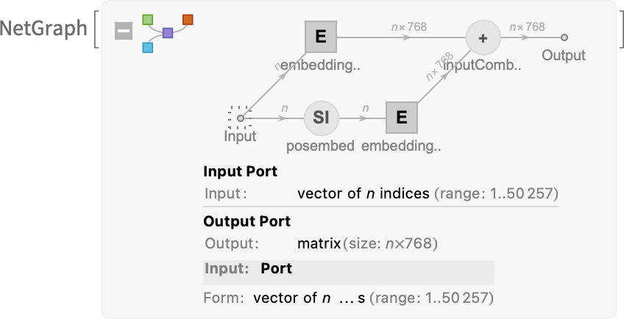
Inside ChatGPT
First comes the embedding module. Here’s a schematic Wolfram Language representation for it for GPT-2:
Notes:
length 768 for GPT-2 and 12,288 for ChatGPT’s GPT-3

Slide 26
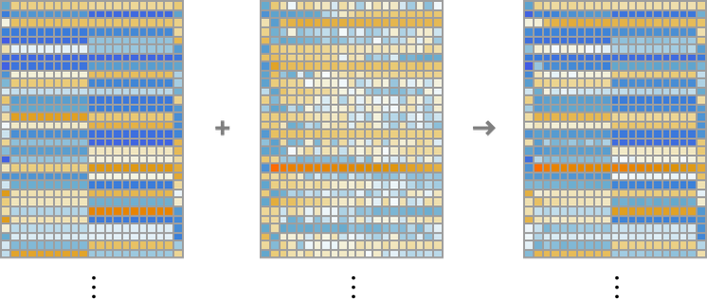
Inside ChatGPT
Here’s what the embedding module does, operating on the string hello hello hello hello hello hello hello hello hello hello bye bye bye bye bye bye bye bye bye bye:

Slide 27
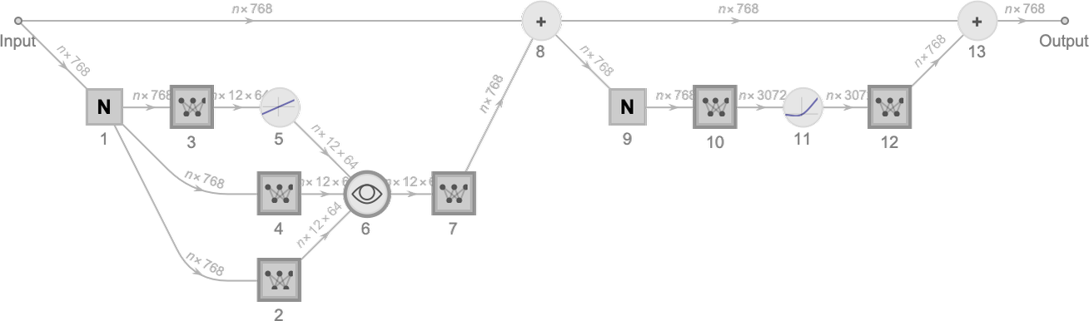
Inside ChatGPT
After the embedding module comes the “main event” of the transformer: a sequence of so-called “attention blocks” (12 for GPT-2, 96 for ChatGPT’s GPT-3)

Slide 28
Inside ChatGPT
Basically the attention heads are a way of “looking back” in the sequence of tokens (i.e. in the text produced so far), and “packaging up the past” in a form that’s useful for finding the next token.
At a more detailed level, what an attention head does is to recombine chunks in the embedding vectors associated with different tokens, with certain weights.

Slide 29
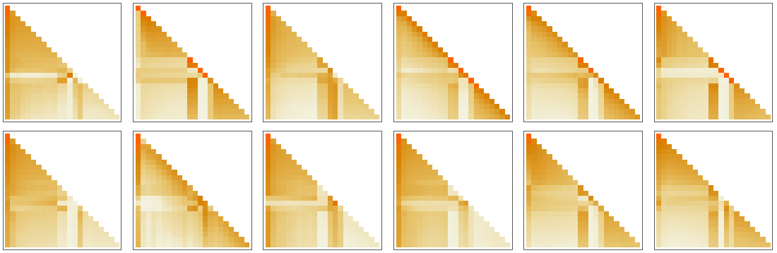
Inside ChatGPT
Basically the attention heads are a way of “looking back” in the sequence of tokens (i.e. in the text produced so far), and “packaging up the past” in a form that’s useful for finding the next token.

Slide 30
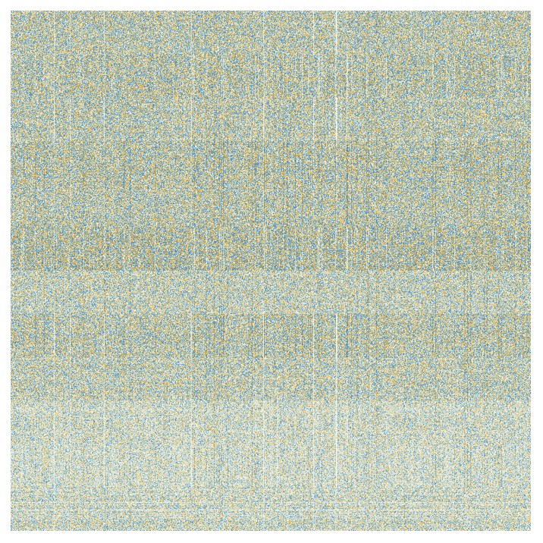
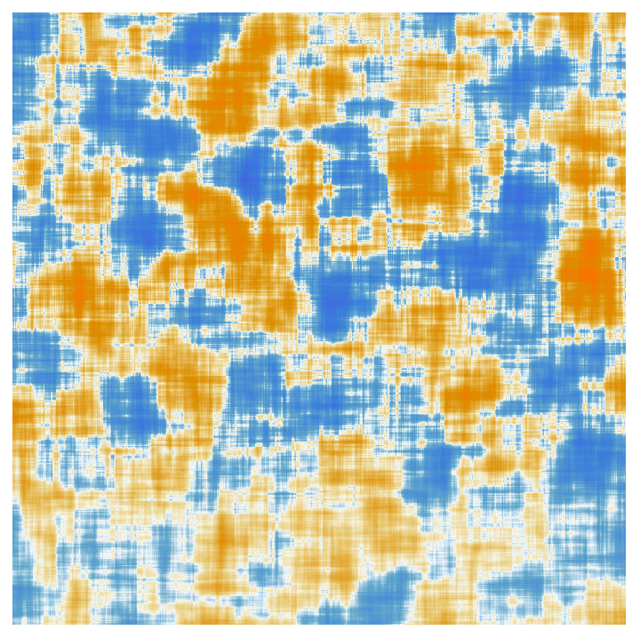
Inside ChatGPT
After being processed by the attention heads, the resulting “re-weighted embedding vector” (of length 768 for GPT-2 and length 12,288 for ChatGPT’s GPT-3) is passed through a standard “fully connected” neural net layer.

Slide 31
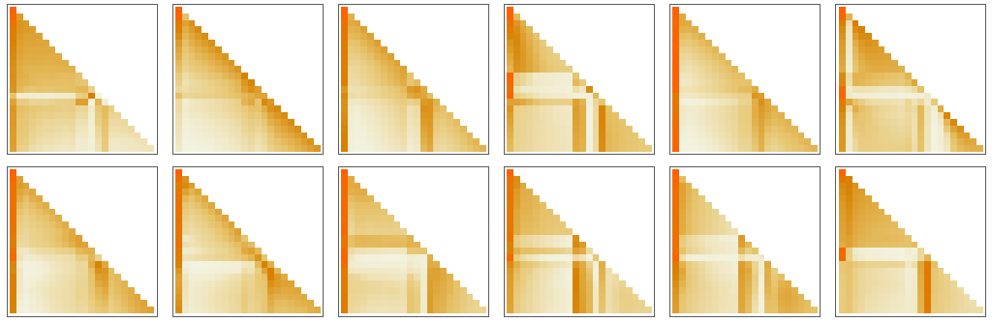
Inside ChatGPT
Each attention block has its own particular pattern of “attention” and “fully connected” weights.

Slide 32
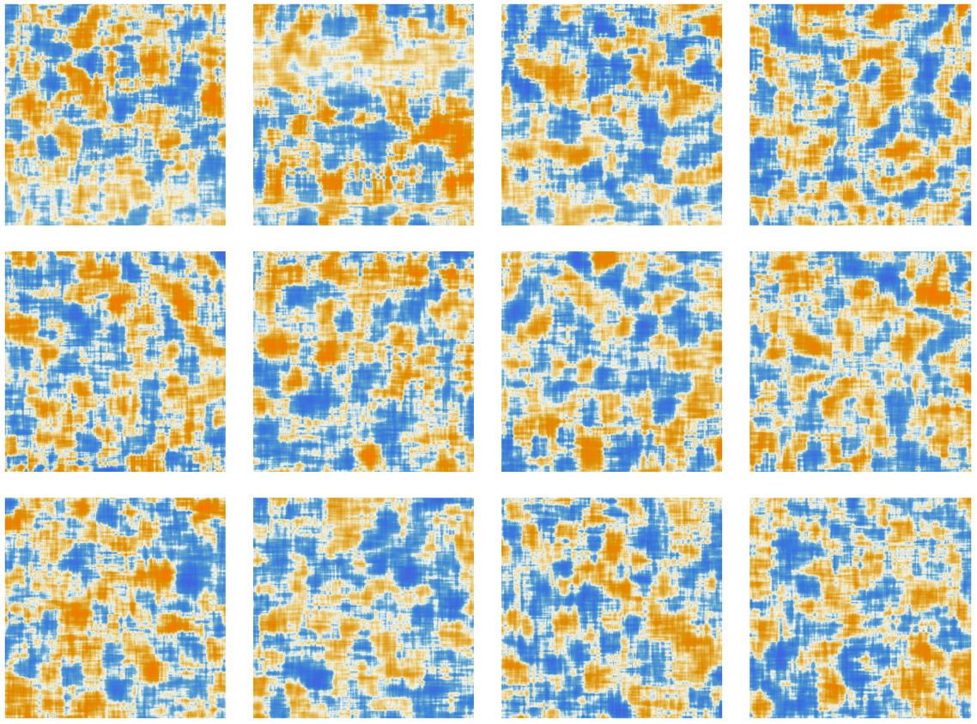
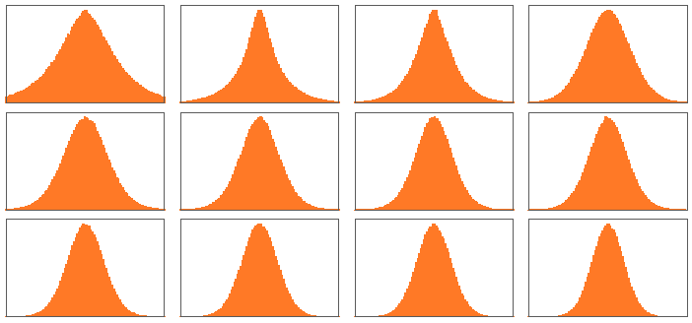
Inside ChatGPT
Each attention block has its own particular pattern of “attention” and “fully connected” weights.

Slide 33
Inside ChatGPT
So after going through all these attention blocks what is the net effect of the transformer?
Essentially it’s to transform the original collection of embeddings for the sequence of tokens to a final collection.
And the particular way ChatGPT works is then to pick up the last embedding in this collection, and “decode” it to produce a list of probabilities for what token should come next.

Slide 34
未完待续
谢谢

